Slide 1
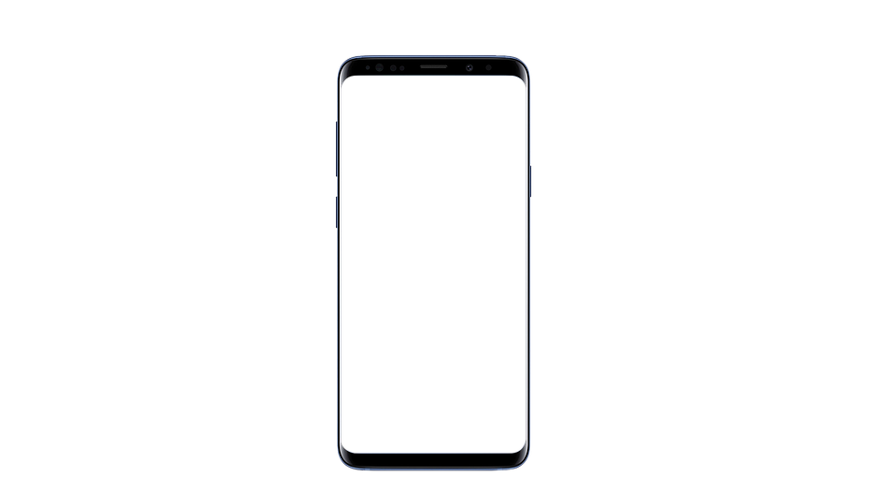
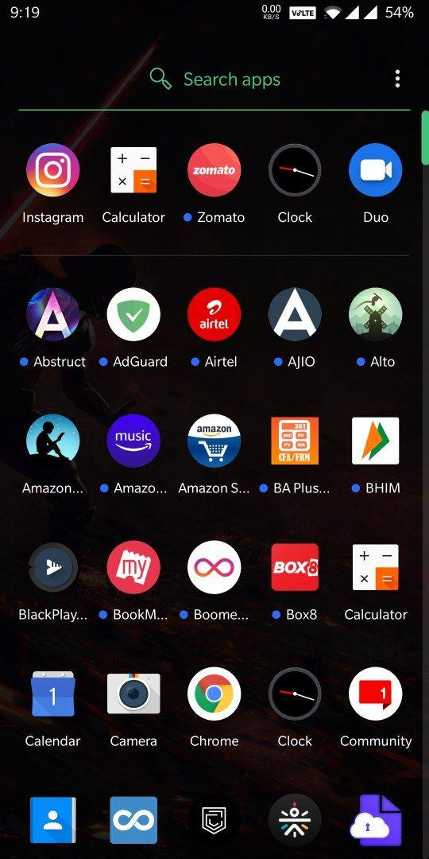

Calorie Intake
Recommendation & Tracking

Slide 2
Content
Problem Statement
Reason and Justification
Supporting Information
Idea Behind the App
Wireframe
App Architecture
Why it’s Better
What next?

Slide 3
Problem statement
The user can enter the food items consumed [item(s) and quantity] and identify actual calorie intake to match that with recommended calories.
The solution can help the user to identify his weight goals : Lose/ Maintain/ Gain and how much to lose/ gain.

Slide 4
Reason and Justification
Nowadays everyone is concerned about their Health and Fitness, but none of them are not willing to take any action for it.
We have come up with a simple solution, we as a team will be developing an application which helps the users to track their fitness goals and their diet

Slide 5
Why we are developing an app
82%
Users are tracking fitness via an application

Slide 6
Idea Behind The App
Most of us don’t realize how many calories is actually present in the food that we consume.
For humans, healthy fats are essential, and also since healthy and clean food can be high in calories and these can add up easily, so they should be tracked.
The main motive behind this app is to meet people health goals and stay on track.

Slide 7
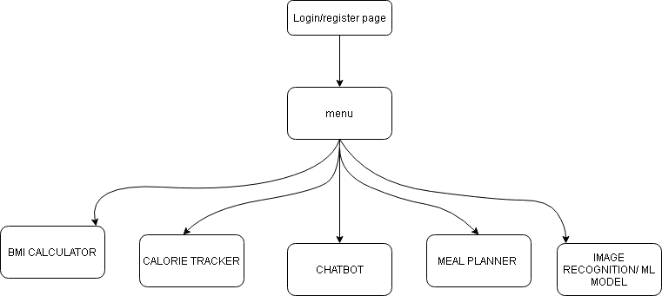
Wireframes

Slide 8
APP ARCHITECTURE
The user would be able to create an account and create a profile, where all the analytics will be stored for later references.
Once the user has created an account he/she is redirected to a menu where the user can decide among the following:
Chatbot
Calorie Tracker
Meal Planner
BMI Calculator
The chatbot is an interactive bot named 'Eve', she will guide you through all type of FAQ's asked by the user and doubts regarding the meal plan.
The Calorie Tracker keeps a track on the calorie of the user from breakfast, lunch, dinner and snacks. The user can input the food he would like to have and the slider will automatically slide it to the right amount of calories.
The Meal Planner which suggests the possible meals to consume based on the target calorie intake provided by the end-user. So basically it lets you enter the amount of calories you wish to consume for the whole day and the app compiles a meal plan (breakfast, lunch, dinner) along with the recipes.
The BMI Calculator keeps a regular check on your BMI index when you enter in your height and weight.
Notes:
GO TO THE LIVE EMULATOR OF OUR APP AND DEMO IT. READ FROM THIS PAGE.

Slide 9
Why it’s better than existing solutions
As a whole the entire app is personalized and user-friendly with a lot of features.
The Meal Planner suggests meal plans along with the recipe
The Chatbot in our app can act as a virtual assistant and provide calorie intake recommendations
People these days snap pictures of foods and put it up in social media, so we have implemented a Visual Calorie Counter which is an image recognition deep learning model which provides calories and various other information for the user before sharing it in a social media platform

Slide 10
What next?
Sometimes it takes a friend to make you see clearly. Our vision for the app is to make it an interface where people from different walks of life can come together and share their goals and diet plan. The app will merely be a platform to share fitness tips and maintain nice relations between fitness enthusiasts all over the world
Our chatbot has endless opportunities for growth . during this pandemic and other global issues the chatbot can prove to be a source of endless information. It can be developed to include a covid 19 dashboard as well.
Premium version

Slide 11
Questions?

